Slide 1
Chapter 1
Recurrent Problem

Slide 2
What is Recurrence?
The solution to a problem can be constructed from the solutions to smaller instances of the same problem.

Slide 3
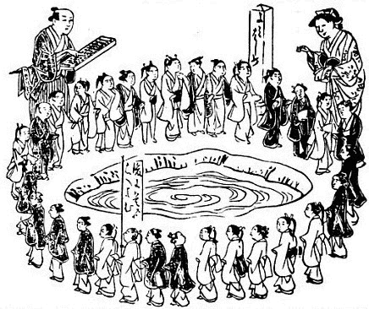
The Josephus Problem
Background:
Flavius Josephus is a Jewish historian living in the 1st century. According to his account, he and his 40 comrade soldiers were trapped in a cave, surrounded by Romans. They chose suicide over capture and decided that they would form a circle and start killing one by skipping every two others. By luck, or maybe by the hand of God, Josephus and another man remained the last and gave up to the Romans.

Slide 4
Problem Definition
Given:
n people numbered 1 to n around a circle
Rules:
Eliminate every second remaining person until only one survives.
Problem:
Determine the survivor’s number.

Slide 5
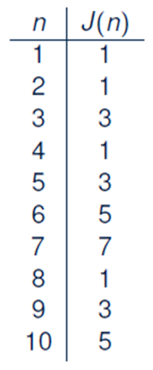
Strategy
Introduce appropriate notation:
J(n) denotes the survivor’s assigned number.
Look at small cases first:

Slide 6
Insights from Small Cases
We may start with:
An even number 2n of people
An odd number 2n + 1 of people
First round eliminates all people assigned with even numbers.
2n is the last person eliminated in the first round.

Slide 7
A General Solution Pattern
Consider the cases of starting number of people separately:
An even number 2n of people:
After 1st round, n people remain: 1, 3, 5, …., 2n-3, 2n-1
How would the survivor of these n people relate to J(n)?
J(2n) = 2J(n)-1
An odd number 2n + 1 of people
After 1st round, n+1 people remain: 1, 3, 5, …, 2n-3, 2n-1, 2n+1
In order to relate to J(n), we need to eliminate one more person.
After the first elimination in 2nd round, n people remain:
3, 5, .... , 2n-3, 2n-1, 2n + 1
How would the survivor of these n people relate to J(n)?
J(2n + 1) = 2J(n) + 1

Slide 8
Recurrence Relation for J(n)
We end up with the following recurrence relation, split into the
cases of the starting number of people being even or odd:
J(1) = 1
J(2n) = 2J(n) - 1 for n > 0
J(2n + 1) = 2J(n) +1 for n > 0
That is, the solution to the original problem can be constructed from the solution to a half-size subproblem.
Question: How many times of unfolding are required for calculating
J(100)? >> 6 times: J(50), J(25), J(12), J(6), J(3), J(1)
However, the above relation only gives us indirect information.
Instead, we need a closed-form solution to the above recurrence relation.

Slide 9
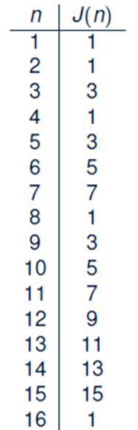
Guessing Closed Form for J(n)

Slide 10
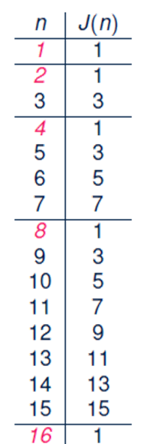
Pattern of the Closed Form for J(n)

Slide 11
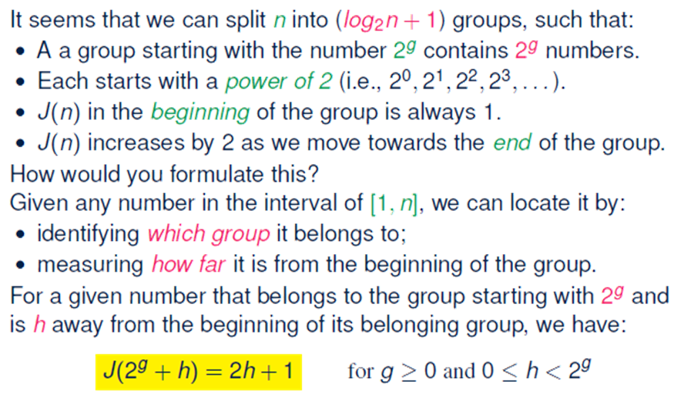
A Hypothesized Closed Form for J(n)

Slide 12
Practice Problem
Prove the closed form of J(n) using Induction Method.

